Slide 1

Basic .NET - part 2

Slide 2

Agenda
Http
rest
Web api
Data transfer object(Dto)
swagger
Dependency injection

Slide 3
Agenda
Http
rest
Web api
Data transfer object(Dto)
swagger
Dependency injection

Slide 4
Hypertext Transfer Protocol (HTTP)
is a standardized protocol used for transmitting and receiving information over the internet.
defines how messages are formatted and transmitted between web browsers (clients) and web servers.
It specifies the structure and semantics of requests and responses exchanged between client and server.
is a foundation for web communication.

Slide 5
Agenda
Http
rest
Web api
Domain transfer object (Dto)
swagger
Dependency injection

Slide 6
REpresentational State Transfer (REST)
REST is an architectural style.
REST emphasizes the concept of resources and provides guidelines for their identification, representation, and manipulation.
RESTful APIs use HTTP methods (GET, POST, PUT, DELETE) to perform CRUD operations on resources.
REST APIs typically use URLs (Uniform Resource Locators) to identify resources and employ standard HTTP status codes to indicate the outcome of requests.

Slide 7
Agenda
Http
rest
Web api
Data transfer object (Dto)
swagger
Dependency injection

Slide 8
Web Api
A web API, or Application Programming Interface, is a set of rules and protocols that allows different software applications to communicate and interact with each other over the internet
Web APIs are commonly used to enable integration between different systems, allowing them to share data and functionality.
They serve as the interface through which developers can interact with remote servers, databases, or services to retrieve data, submit data, or perform specific actions.

Slide 9
Web Api
Routing: define routes that map incoming HTTP requests to specific actions or methods in the code. This allows developers to define endpoints and specify how they should be accessed.
Controllers: responsible for handling HTTP requests and generating appropriate responses.
Serialization: .NET Web APIs handle serialization and deserialization of data, typically in formats like JSON or XML. They can automatically convert objects to the desired format when sending responses and parse incoming data into objects.
Content Negotiation: Web APIs support content negotiation, allowing clients to request data in a specific format (e.g., JSON or XML) using the Accept header. The API can then respond with the requested format if it's supported.
Security: .NET Web APIs provide mechanisms for authentication and authorization, allowing developers to secure their APIs and control access to specific resources or actions.
HTTP Verbs: Web APIs use HTTP verbs (GET, POST, PUT, DELETE, etc.) to represent different actions or operations. These verbs indicate the type of operation to be performed on a resource.
Error Handling: handle and return appropriate HTTP status codes and error responses when errors occur during processing. This helps clients understand the outcome of their requests.

Slide 10
Agenda
Http
rest
Web api
Data transfer object (Dto)
swagger
Dependency injection

Slide 11
Data Transfer Object (DTO)
is to facilitate the transfer of data between different parts of a system while decoupling the internal representation of data from its external representation.
commonly used in scenarios such as web APIs, service-oriented architectures (SOA), microservices, and distributed systems, where data needs to be transmitted between different components or across network boundaries

Slide 12
Agenda
Http
rest
Web api
Domain transfer object (Dto)
swagger
Dependency injection

Slide 13
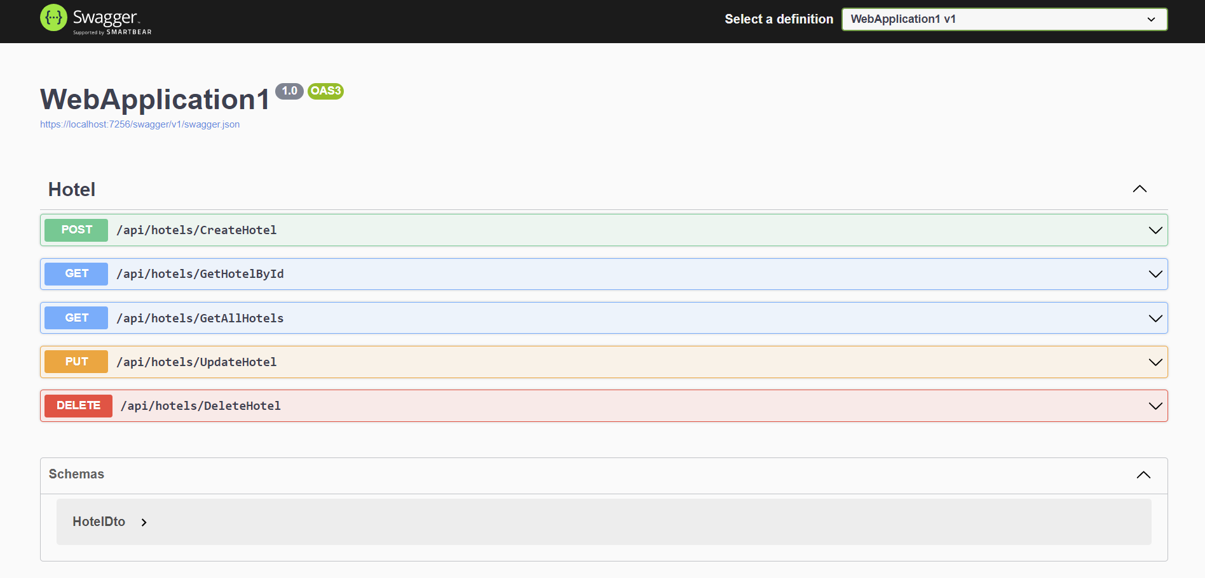
Swagger
Swagger UI is an open-source tool that provides a web interface for visualizing and interacting with APIs

Slide 14
Agenda
Http
rest
Web api
Domain transfer object (Dto)
swagger
Dependency injection

Slide 15
Dependency Injection (DI)
is a design pattern and a principle in software development that promotes loose coupling and modularity.
It promotes loose coupling, testability, and modular design.

Slide 16
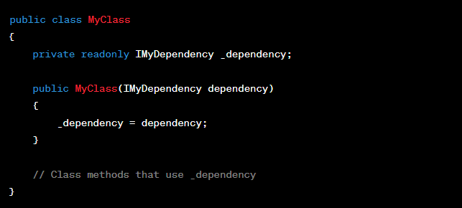
Dependency Injection Types
Constructor Injection: This is the most recommended and widely used method. Dependencies are injected through a class's constructor

Slide 17
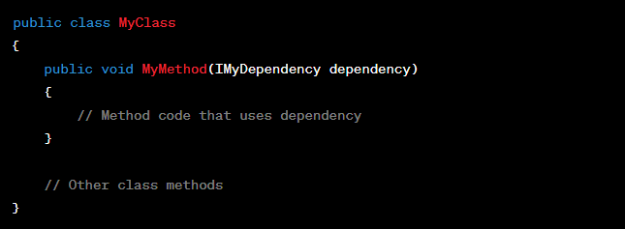
Dependency Injection Types
Method Injection: Dependencies can be injected into specific methods when needed.

Slide 18
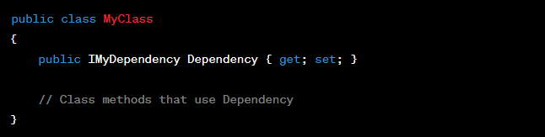
Dependency Injection Types
Property Injection : Dependencies are injected into public properties of a class. Property injection can be useful for optional dependencies or scenarios where modifying the constructor is not feasible.

Slide 19
Dependency Injection Container
In .NET Core, the DI container is a built-in feature provided by the framework to facilitate dependency injection.
The DI container manages the creation and lifetime of objects, resolves dependencies, and injects them into consuming classes.
It supports registering services with different lifetimes such as Transient, Scoped, and Singleton.

Slide 20
Service lifetime
Transient dependencies are created each time they are requested. A new instance is provided for each injection. Transient lifetime is suitable for lightweight, stateless services where a new instance is desired for each use.
Scoped dependencies are created once per scope. A scope usually corresponds to a web request in the context of a web application. Within the same scope, the same instance is provided for all injections. Scoped lifetime is useful when you want to share a service within the scope of a single request or unit of work.
Singleton dependencies are created once and the same instance is provided for all subsequent injections. The instance is shared across the entire application's lifetime. Singleton lifetime is suitable for stateful services or services that are expensive to create and can be shared safely among multiple clients.

Slide 21


Thank you!
Hollo David-Stefan
davidstefan.hollo@endava.com

